Slide 1
Experiment 1: Individual Protein Results

Slide 2
NSP1
Length of REF Genome: 540
Total samples: 868
Shape of training set : torch.Size([473, 12, 12]), Shape of target set: torch.Size([473, 12])
Shape of validation set : torch.Size([197, 12, 12]), Shape of target set: torch.Size([197, 12])
Shape of test set : torch.Size([162, 12, 12]), Shape of target set: torch.Size([162, 12])
Length of train dataloader 8, length of validation dataloader 4, and length of test dataloader 3
LSTMModel: test_loss = 1.065171241760254
GRUModel: test_loss = 1.060937523841858
LSTMModel_reducedHiddenSize: test_loss = 1.0934067964553833
GRUModel_reducedHiddenSize: test_loss = 1.1142507791519165
LSTMModel_reducedHiddenSize_reducedFCs: test_loss = 1.1734369993209839
GRUModel_reducedHiddenSize_reducedFCs: test_loss = 1.259429931640625
LSTMModel_increasedHiddenSize_moreFCs: test_loss = 1.1342267990112305

Slide 3
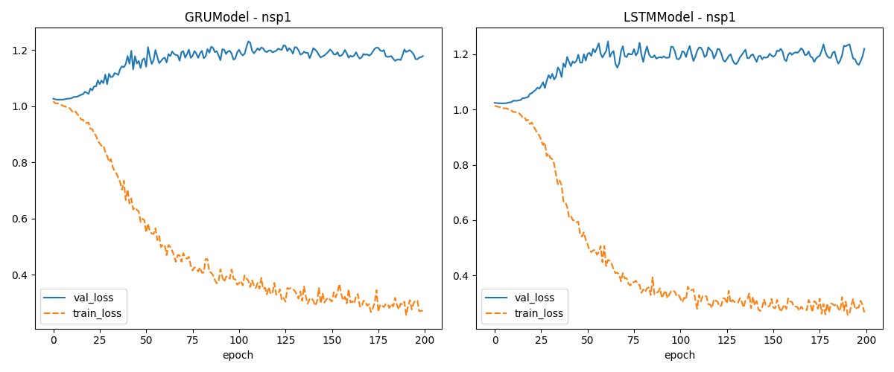
Model comparison – default LSTM

Slide 4
NSP3
Length of REF Genome: 5835
Total samples: 13358
Shape of training set : torch.Size([7468, 12, 12]), Shape of target set: torch.Size([7468, 12])
Shape of validation set : torch.Size([3194, 12, 12]), Shape of target set: torch.Size([3194, 12])
Shape of test set : torch.Size([2660, 12, 12]), Shape of target set: torch.Size([2660, 12])
Length of train dataloader 117, length of validation dataloader 50, and length of test dataloader 42
LSTMModel: test_loss = 1.0941812992095947
GRUModel: test_loss = 1.100252628326416
LSTMModel_reducedHiddenSize: test_loss = 1.1181966066360474
GRUModel_reducedHiddenSize: test_loss = 1.1195363998413086
LSTMModel_reducedHiddenSize_reducedFCs: test_loss = 1.1575032472610474
GRUModel_reducedHiddenSize_reducedFCs: test_loss = 1.139958381652832
LSTMModel_increasedHiddenSize_moreFCs: test_loss = 1.1517560482025146

Slide 5
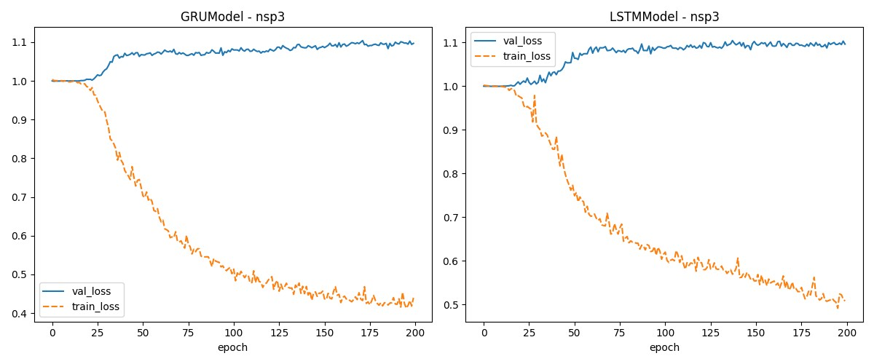
Model comparison – default LSTM

Slide 6
NSP13
Length of REF Genome: 1803
Total samples: 2678
Shape of training set : torch.Size([1487, 12, 12]), Shape of target set: torch.Size([1487, 12])
Shape of validation set : torch.Size([631, 12, 12]), Shape of target set: torch.Size([631, 12])
Shape of test set : torch.Size([524, 12, 12]), Shape of target set: torch.Size([524, 12])
Length of train dataloader 24, length of validation dataloader 10, and length of test dataloader 9
LSTMModel: test_loss = 1.137581467628479
GRUModel: test_loss = 1.136352777481079
LSTMModel_reducedHiddenSize: test_loss = 1.1436958312988281
GRUModel_reducedHiddenSize: test_loss = 1.1642522811889648
LSTMModel_reducedHiddenSize_reducedFCs: test_loss = 1.2852940559387207
GRUModel_reducedHiddenSize_reducedFCs: test_loss = 1.346616268157959
LSTMModel_increasedHiddenSize_moreFCs: test_loss = 1.1232903003692627

Slide 7
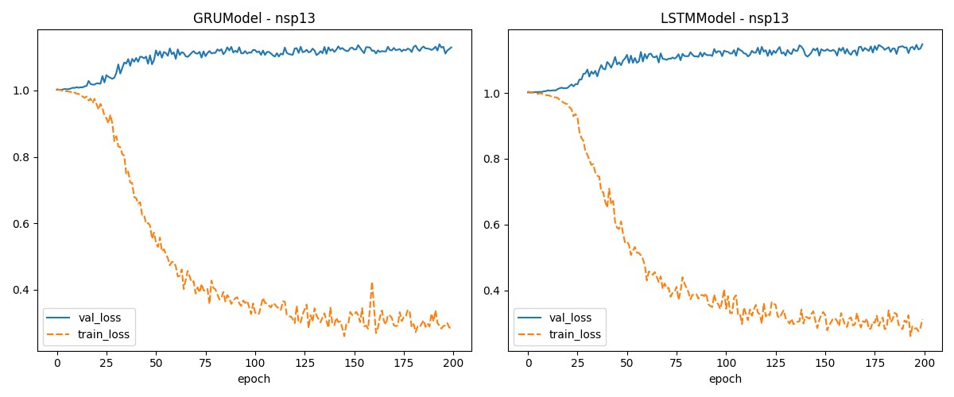
Model comparison – default LSTM

Slide 8
NSP15
Length of REF Genome: 1038
Total samples: 1236
Shape of training set : torch.Size([679, 12, 12]), Shape of target set: torch.Size([679, 12])
Shape of validation set : torch.Size([285, 12, 12]), Shape of target set: torch.Size([285, 12])
Shape of test set : torch.Size([236, 12, 12]), Shape of target set: torch.Size([236, 12])
Length of train dataloader 11, length of validation dataloader 5, and length of test dataloader 4
LSTMModel: test_loss = 1.086350679397583
GRUModel: test_loss = 1.0502307415008545
LSTMModel_reducedHiddenSize: test_loss = 1.12787926197052
GRUModel_reducedHiddenSize: test_loss = 1.106589436531067
LSTMModel_reducedHiddenSize_reducedFCs: test_loss = 1.1981487274169922
GRUModel_reducedHiddenSize_reducedFCs: test_loss = 1.226509928703308
LSTMModel_increasedHiddenSize_moreFCs: test_loss = 1.0489522218704224

Slide 9
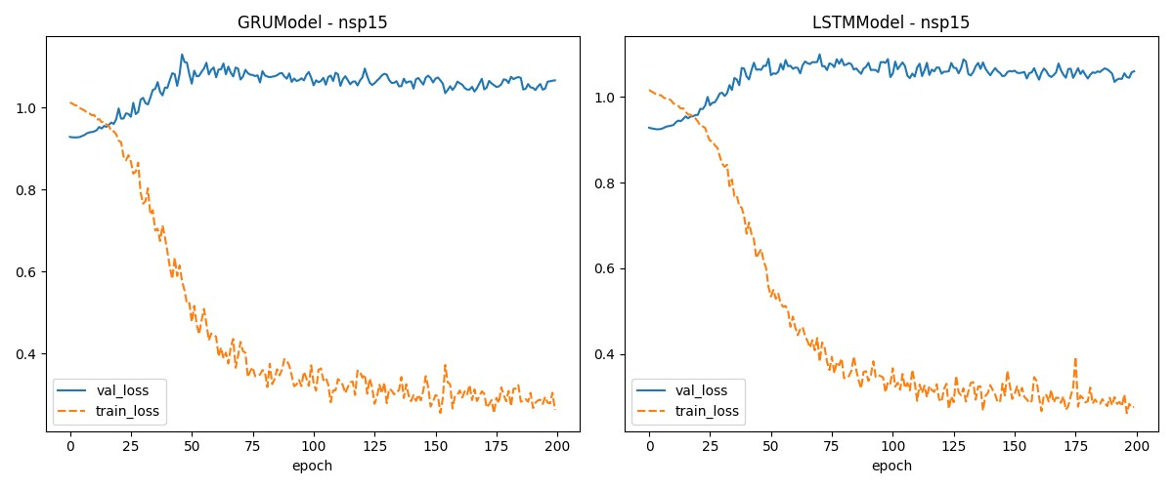
Model comparison – default LSTM

